Slide 1

Making plans for your Groups

Slide 2

Building your ideas and plans
In your country groups you have already had a lot of discussion
You have started to make plans for your activities in this project (some of you might be quite far along).
In the next few hours we will review your ideas and I will introduce a way of thinking about your work to help you reflect on your plans, and hopefully strengthen them.

Slide 3

Three stages
Who you are, your priorities and aims
Developing plans
Making a timeline
There will be a lot of post it notes!
You can take pictures to record your work.
You may not finish all your thinking – that is okay, this is a starting point that you can build on in the coming months.

Slide 4
Part 1: Who are we, and what are our priorities and aims?
On your own, write on 3 post it notes:
  Who are you and what do you do
  What is your no.1 aim for this project – what would you like to be different at the end of the project?
  What is the top priority for what your country group could do to help make that change?

Slide 5
Sharing ideas
As a group:
  Each person share what is written on your post-it notes. (try not to get into discussion! Just share what you have written).
  Gather the post-it notes into three groups: who we are, our aims, our activities
  Finish with some discussion about your ideas for aims and activities:
    do you have questions for each other?
    are there themes in what you have written?
    What else do you notice?

Slide 6
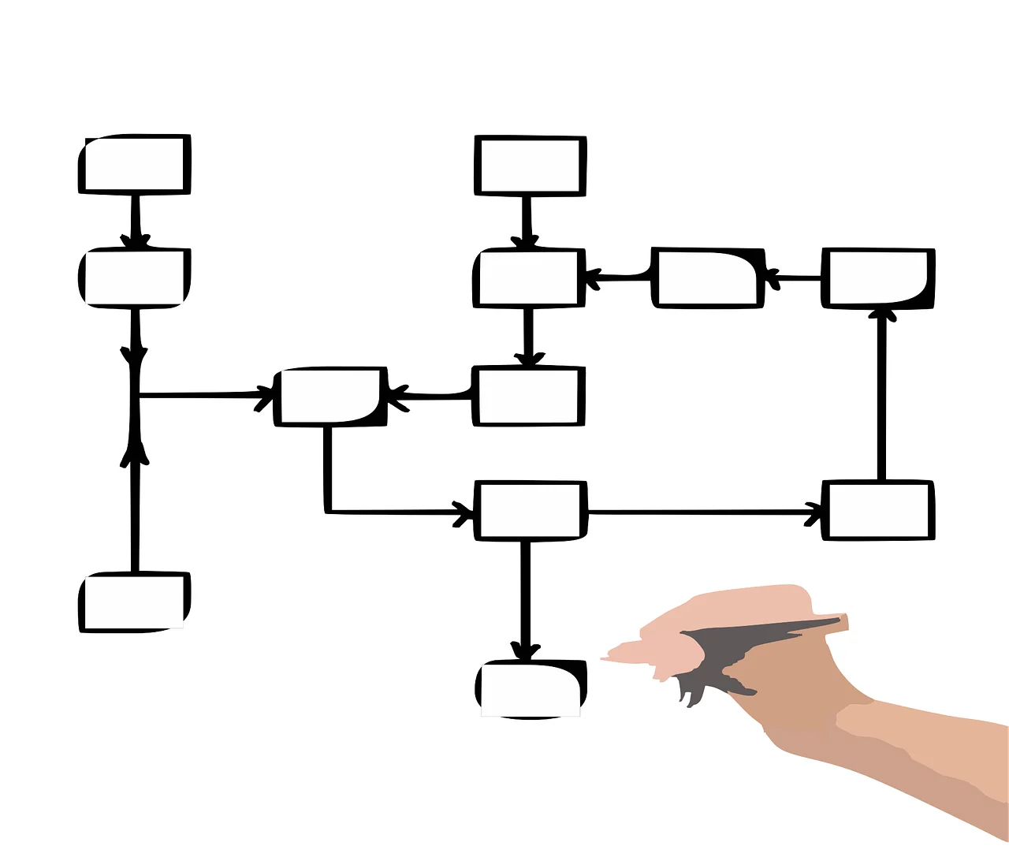
Part 2: Turning aspirations into plans
Now you have a set of ideas of aims and activities – and have discussed some priorities
We will now build a more elaborated plan about how to take these forward using a structured approach: a theory of change

Slide 7
Theory of Change
A theory of change helps you to ‘think through’ an activity from what you plan to do to what you hope it will achieve.
It helps to identify the ‘theory’ of how you think your activity will achieve the impacts you want it to
It helps to identify assumptions you are making….
…which can help you refine your plans
A theory of change also helps with evaluation because you can evaluate if the activities are achieving the outcomes in the ways you expect.

Slide 8
Theory of change process
Inputs: resources
Activities: what you will do
Outputs: what the project directly produces or delivers
Outcomes: short term changes that will happen (often to your target group)
Impact: the broader, longer-term change you ultimately want to contribute to
Assumptions: why we think the change will happen
Context: what might enable, constrain or alter the pathway

Slide 9
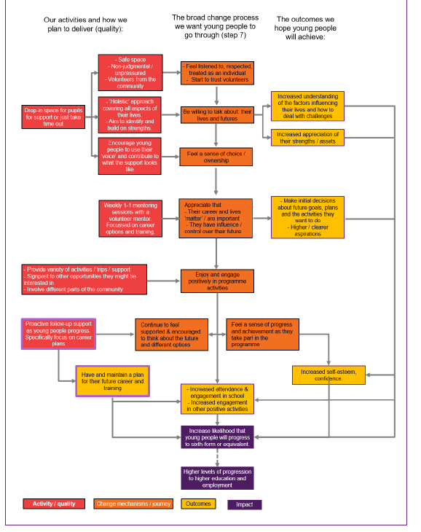
Example (1)
From Noble (2019) Theory of Change in 10 steps

Slide 10
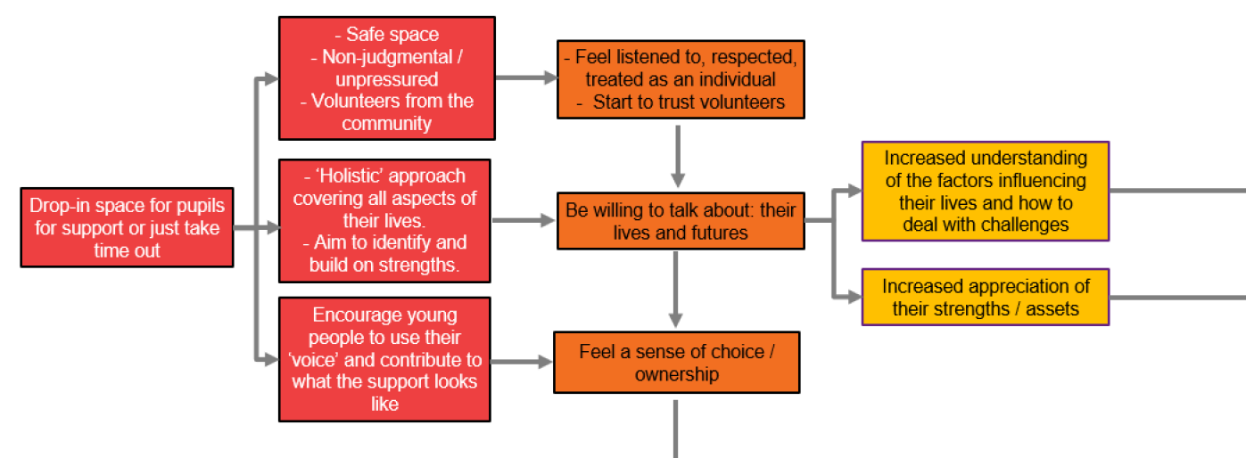
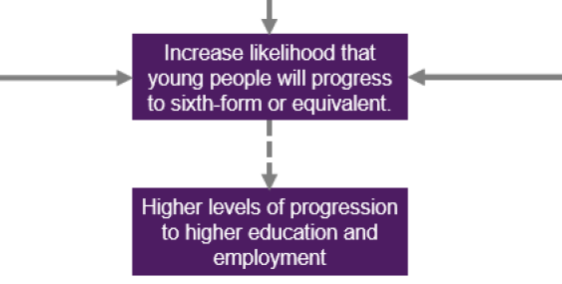
Example (1)
From Noble (2019) Theory of Change in 10 steps

Slide 11
Example (1)
From Noble (2019) Theory of Change in 10 steps

Slide 12
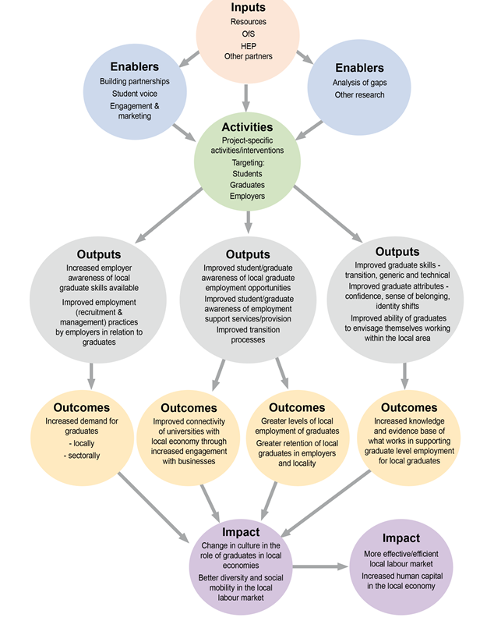
Example (2)
Alexander, Hooley and Mellors-Bourne (2023) Supporting Local Students and Graduates

Slide 13
Your turn: building a theory of change
What is the fundamental aim of your work in your country?
  My guess: Improving support to NEET young people
  Contributing to the wider impact: reducing levels of NEET young people
Work back from that aim. What would need to happen to achieve this aim? What activities do you need to do and how are they going to help?
Start to build the logic:
What we will do → What will change → What will change next → Longer-term change

Slide 14
Conduct Research
Improve support for NEET young people

Slide 15
What data will this gather? Why will this help? How will change happen?
Conduct Research
Improve support for NEET young people

Slide 16
What data will this gather? Why will this help? How will change happen?
Conduct Research
Improve support for NEET young people
Identify what young people feel they need
Practitioners adapt their work
Communicate findings to practitioners

Slide 17
What data will this gather? Why will this help? How will change happen?
Conduct Research
Improve support for NEET young people
Identify what young people feel they need
Practitioners adapt their work
Communicate findings to practitioners
?
Training for practitioners

Slide 18
Your turn: building a theory of change
What is the fundamental aim of your work in your country?
  My guess: Improving support to NEET young people
  Contributing to the wider impact: reducing levels of NEET young people
Work back from that aim. What would need to happen to achieve this aim? What activities do you need to do and how are they going to help?
Keep thinking about assumptions: what are we assuming in this process? What might we need to do about these assumptions?

Slide 19
Finishing touches: Note your assumptions and contextual factors
What assumptions are you making?
What important contextual factors might complicate the process?
(You may like to think about these in other terms e.g. dependencies and risks)
Write these down

Slide 20

Part 3: timeline and responsibilities
Look at your theory of change
What needs to happen and when to achieve your goals?
Who will do these things?

Slide 21
Gather your actions into a timeline
Before Christmas 2026 | Spring 2027 (Jan-March) | Summer 2027 Apr-Sept (Faroe islands) | Winter 2027 (Oct-Dec) | Spring 2028 (Jan – March) Åland meeting)

Slide 22

Share your ideas with each other

